Slide 1
KONSEP TEKNOLOGI INFORMASI INDUSTRI pertemuan 3
ariadi retno

Slide 2
REFERENSI
DEVELOPMENT, CHALLENGES AND IDEAS OF DIGITAL TRADE
Wang Xiaohong
王晓红

Slide 3
tugas kelompok emailkan di faniri4education@gmail.com tulis nama anggota dan tugas setiap anggota
buatlah salah satu contoh penerapan KTI di aplikasi industri dan jelaskan
online office, education, entertainment, medical care, exhibition, mobile payment, culture, sport.

Slide 4

DEVELOPMENT, CHALLENGES AND IDEAS OF DIGITAL TRADE
The 14th Five-Year Plan puts forward the strategic plan to promote trade innovation and development. Digital trade is the leader of trade innovation and development, and it is also the focus for countries to compete for the commanding heights of international trade competition strategy and the dominance of rule making.
I Definition and main characteristics of digital trade
1. WTO
The Manual on Statistics of International Trade in Services, jointly developed by six international organizations, including the United Nations and WTO, divides digital trade into tangible goods and intangible goods, and defines it as a transaction through online ordering. In the Work Plan of E-Commerce adopted by WTO in 1998, e-commerce replaced digital trade and defined it as "producing, distributing, marketing, selling or delivering goods and services by electronic means".

Slide 5

DEVELOPMENT, CHALLENGES AND IDEAS OF DIGITAL TRADE
2. America
The United States was the first country to pay attention to digital trade, define it and introduce regulatory measures. In July, 2013, the United States International Trade Commission (USITC) first put forward the concept of “digital trade” in Digital Trade in the US and Global Economy, that is, to realize the commercial activities of products and services through Internet transmission.
In August 2014, USITC included physical goods in the object of transaction of digital trade in Digital Trade in the US and Global Economy, emphasizing that digital trade is a trade realized by digital technology, and interpreted it as domestic business and international trade activities in which Internet and Internet technology play a key role in ordering, producing and delivering products and services.
In 2017, the United States Trade Representative Office (USTR) released Main Barriers to Digital Trade, which further expanded the extension of digital trade. It is considered that digital trade includes not only the sales of personal consumer goods on the Internet and the provision of online services, but also the data flow to realize the global value chain, the services to realize intelligent manufacturing and other platforms and applications. It is divided into four categories: digital content, social media, search engines and others.

Slide 6
DEVELOPMENT, CHALLENGES AND IDEAS OF DIGITAL TRADE
3. OECD
In March 2020, OECD, WTO and IMF published the Handbook on Measuring Digital Trade, which defined digital trade as "all trade through digital ordering and/or digital delivery". According to the nature of transactions, digital trade is divided into three components in the OECD-WTO framework:
 Digitally ordered trade
 Digitally delivered trade
Digital intermediation
platform services-enabled trade
Emphasize "buying and selling on the computer network through the method specially used for receiving or placing orders"
Emphasize "all cross-border transactions delivered remotely in electronic downloadable format through ICT network"
Mainly refers to the behavior of providing trading platform and intermediary services for buyers and sellers.

Slide 7
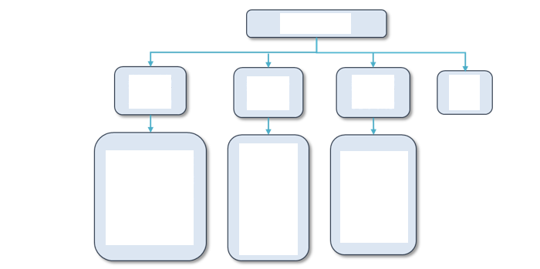
DEVELOPMENT, CHALLENGES AND IDEAS OF DIGITAL TRADE
4. China
Digital trade is a new trade format with digital technology as the means, digital service as the core and digital delivery as the nature, which mainly includes information technology services, digital content services and offshore service outsourcing.
The Ministry of Commerce has recently divided it into 4 types: digital trade in technologies, digital trade in products, digital trade in services and data trade.
As a knowledge-intensive service trade covering digital delivery of information and communication technology, digital entertainment, finance, insurance, education, medical care, intellectual property and other business services, it is an important support for industrial innovation, structural upgrading and smooth internal and external circulation.
Digital trade
Digital Trade in technologies
Digital Trade in
products
Digital Trade in
services
Data trade
Software, communications, big data, AI, cloud computing, blockchain, industrial Internet and other technologies for cross-border trade
Data game
Digital publishing
Digital Film and Television
Digital animation
Digital advertising
Digital music
Cross-border e-commerce platform finance, insurance, education, healthcare, intellectual property
Figure Classification method of digital trade
Note: drawn according to the latest classification of the Ministry of Commerce

Slide 8
DEVELOPMENT, CHALLENGES AND IDEAS OF DIGITAL TRADE
Energetically developing the trade in services. We will deepen the reform and opening-up in the field of service trade, continue to promote the pilot innovation and development of service trade, and improve the management system and policy system to promote the development of service trade. Accelerate the development of digital trade in services. Promote the construction of export bases for characteristic services in the fields of culture, digital services and traditional Chinese medicine services.
IV Achieve balance and coordination to promote sustainable trade
(x) Actively expand imports. Further reduce import tariffs and institutional costs in a timely manner, stimulate import potential and optimize import structure. Expand the import of advanced technology, equipment and spare parts. Encourage the import of domestic resource products in need. Support the import of daily consumer goods, medicines, rehabilitation, aged care and other equipment. Promote the import of productive services such as R&D and design, energy conservation and environmental protection, and environmental services.
(xi) Vigorously develop trade in services. We will deepen the reform and opening-up in the field of service trade, continue to promote the pilot innovation and development of service trade, and improve the management system and policy system to promote the development of service trade. Accelerate the development of digital trade Promote the construction of export bases for characteristic services in the fields of culture, digital services and traditional Chinese medicine services. Improve the technology import and export management system, and establish and improve the technology trade promotion system. Explore the negative list management system of cross-border service trade. Strengthen international cooperation in service trade and build a national brand of "China Service".

Slide 9
Excerpts from the 14th Five-Year Plan for Business Development
DEVELOPMENT, CHALLENGES AND IDEAS OF DIGITAL TRADE
Section IV Innovation and Development of Trade in Services
We should vigorously develop digital trade, establish and improve digital trade promotion policies, actively explore the development of diversified formats, and cultivate various digital trade development demonstration platforms.
Column 6 Key measures for innovative development of trade in services
03 Digital trade promotion action
We should accelerate the cultivation of the main body of digital trade, build a national digital service export base, and build a leading demonstration zone of digital trade. In addition, we will build a public service platform and establish a statistical monitoring system. More importantly, we will expand the opening of digital trade, strengthen international cooperation in digital trade, and actively participate in the formulation of relevant international rules.
Digital trade will accelerate the global flow of capital, technology, talents, knowledge, data, services and other factors, and continuously expand the tradable boundaries of services and expand economies of scale and scope. It can promote the stable development of global industrial chains, supply chains and innovation chain through various digital R&D, production, trade and service platforms, advance innovation efficiency, technology diffusion and open cooperation, and facilitate the global sharing of high-quality service resources such as science and technology, medical care, culture, sports and education. Therefore, digital trade provides innovative power for the high-quality development of trade, and it is also an important carrier for scientific, technological and cultural exchanges between China and other countries, which can offer important strategic support for the construction of a new development pattern.

Slide 10
DEVELOPMENT, CHALLENGES AND IDEAS OF DIGITAL TRADE
（II）Main characteristics
——Virtualization. It refers to the virtualization of circulation of digital products and services, which is characterized by that digital knowledge and information are used in the production process, and transactions are carried out on the digital platform.
——Platformization. A digital platform is the core organization of resource allocation, relying on which an industrial ecosystem and an innovation ecosystem are formed. The platform shares data resources with manufacturers, merchants, payment and logistics parties, and jointly creates values so as to form a digital trade ecosystem.
——Intensification. By relying on big data, digital trade can realize intensive input of factors, and promote accurate matching of R&D, design, procurement, production and marketing.
——Inclusiveness. The wide application of digital technology has greatly lowered the trade threshold, and small and medium-sized enterprises and natural persons can provide services to global consumers through the digital platform.
——Individualization. Provide customized products and services according to the individual needs of consumers.
——Globalization. With the help of digital technology, a global cyberspace can be built to provide service content for the global market, thus promoting the globalization of service production, consumption, and investment as well as digital globalization.

Slide 11
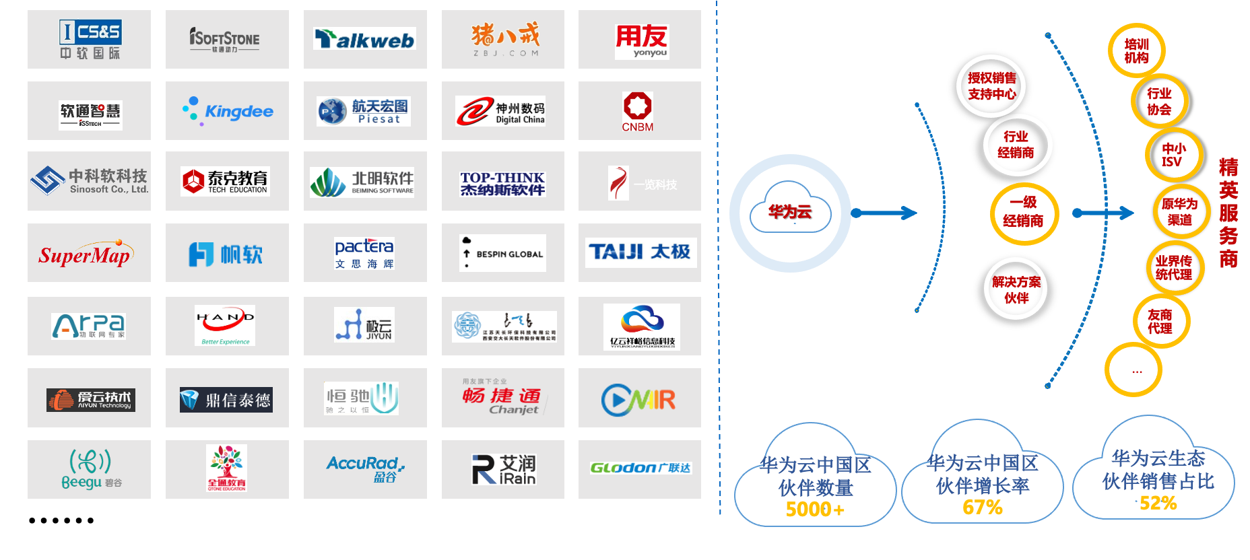
DEVELOPMENT, CHALLENGES AND IDEAS OF DIGITAL TRADE
Ecology of HUAWEI CLOUD: Openness, Collaboration & Altruism
Training institution
Authorized Sales Support Center
Elite Service Provider
Industry Association
Industry Distributor
Small and medium ISV
Huawei Cloud
First-class dealer
Original Huawei channel
Traditional business agent
Solution partner
Friends agent
The number of Huawei Cloud partners in China 5000+
The growth rate of Huawei Cloud partners in China is 67%
Huawei cloud ecosystem partners account for 52% of sales

Slide 12

DEVELOPMENT, CHALLENGES AND IDEAS OF DIGITAL TRADE
The platform effectively realizes collaborative innovation between manufacturers and R&D and design institutions. For example, the Uniorange industrial product collaborative R&D platform has gathered more than 9,000 manufacturers and 250,000 engineers, designers and experts at home and abroad. It took only two years for the platform to release more than 8,000 R&D projects, more than 400 R&D achievements and more than 30 patents at home and abroad.
Commercialization
of research results
Product and market support
Uniorange provides full life-cycle quality services
Intellectual property rights
Trial manufacture and
production of products
Market support
Patent application
Trademark application
Software copyright application
Intellectual property investment and financing
Channel recommendation
Market promotion
Investment and incubation
Product R&D and design
Prototype making
Manufacture
Supply chain integration
Mold processing
Small batch production
Mass production
Digital prototype
Engineering prototype
Prototype test
Product R&D consulting
Detailed design
Solution design
Process design
Engineering drawing design
Electrical design
Hardware and software design
Structure design
Appearance design
Flow chart design
Design calculation
Consultation service
Provide one-stop customized product R&D design overall solution for enterprises in industrial field
Demand definition, product R&D plan
Technical planning consultation and technical innovation consultation

Slide 13
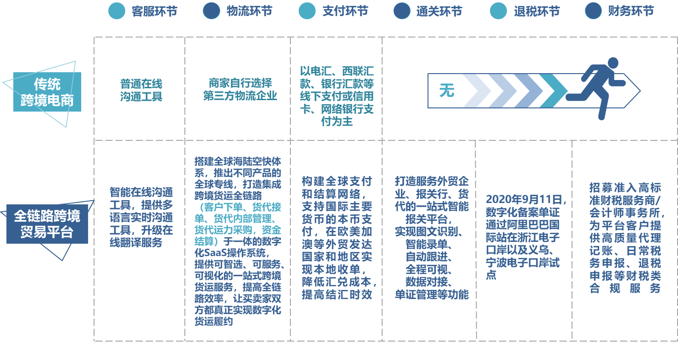
DEVELOPMENT, CHALLENGES AND IDEAS OF DIGITAL TRADE
Customer service link
Logistics link
Payment link
Customs clearance link
Tax rebate link
Financial link
Mainly offline payment such as wire transfer, Western Union, bank transfer, or credit card, online bank payment
Traditional cross-border e-commerce
Ordinary online communication tool
Merchants choose third-party logistics companies on their own
None
Build a global sea, land and air express system, launch global dedicated lines for different products, and build a digital SaaS operating system that integrates the whole cross-border freight link (customer order, freight forwarder order, freight forwarder internal management, freight forwarder capacity procurement and fund settlement), provide intelligent, serviceable and visual one-stop cross-border freight service, improving the efficiency of the whole link, so as to make both buyers and sellers truly realize digital freight performance.
Build a global payment and settlement network, support local currency payment of major international currencies, realize local receipt in developed foreign trade countries and regions such as Europe, America, Canada and Australia, reduce exchange costs and improve the timeliness of foreign exchange settlement.
Create a one-stop intelligent customs declaration platform for foreign trade enterprises, customs brokers and freight forwarders, and realize the functions of image and text recognition, intelligent recording, automatic follow-up, whole-process visualization, data docking, document management, etc.
Recruit high-standard finance and tax service providers/accounting firms, and provide high-quality financial and tax compliance services such as agency bookkeeping, daily tax declaration and tax refund declaration for platform customers.
Intellectualize online communication tools, provide multilingual real-time communication tools, and upgrade online translation services.
On September 11th, 2020, digital filing documents were piloted at Zhejiang Electronic Port and Yiwu and Ningbo Electronic Ports through Alibaba International Station.
Full-link cross-border trade platform
Figure Comparison between traditional cross-border e-commerce and full-link cross-border trade platform

Slide 14
DEVELOPMENT, CHALLENGES AND IDEAS OF DIGITAL TRADE
Open cross-border e-commerce
Customer service link
Export pass
Smart product release
Dingding KP workbench
Jinpin Chengqi
Shop management
Ali seller
Opportunity Communication
/Customer Management
Opportunity acquisition
Commodity management
Inquiry management
IM chat
P4P
Top booth
Star show
Shop window
Product management
Commodity growth system
Customer Pass
Live stream
Data staff
RFQ
3D smart scene
Multimedia platform
Video Center
Order generation
Export declaration
Cargo transportation
Transaction complete
Credit protection service
One Touch - Customs, foreign exchange, taxes
Final payment
Wire transfer
Alibaba international logistics sea, land, and air
Letter of credit
Financial service – e-tax
One Touch - Tax refund service
Collection
Finance & Taxation Service
Customs SAAS

Slide 15
DEVELOPMENT, CHALLENGES AND IDEAS OF DIGITAL TRADE
II Digital trade becomes the main engine leading the innovation and development of trade in services
(i) Digital trade has become the main engine driving the growth of trade in services and optimizing the structure as well as the main channel of college students' employment.
From 2015 to 2020, the digitally-deliverable service trade value has increased from US$200 billion to US$294.76 billion, an increase of 47.4%, with the share in service trade increasing from 30.6% to 44.5%. In 2020, affected by the COVID-19, traditional service trade has fallen sharply (service exports fell by 1.1%, imports fell by 24%), and the import and export of digitally delivered services increased by 8.3%, accounting for 44.5% of the total service imports and exports, of which exports accounted for 55.3% of total service export value.
Except for 2017, the export value of digital trade is greater than the import value, which shows strong competitiveness, and plays an important role in reducing the service trade deficit.
Table 1 Development of China's digital trade during the 13th Five-Year Plan period
Unit: USD 100 million; %
 | 2015 | 2016 | 2017 | 2018 | 2019 | 2020 Years
Total service trade value | 6542 | 6616 | 6957 | 7919 | 7850 | 6617
Digitally deliverable service trade | 2000.0 | 2092.0 | 2079.5 | 2561.8 | 2722.1 | 2947.6
Where, Export | 1137.3 | 1121.5 | 1025.7 | 1321.4 | 1437.5 | 1551.5
Import | 862.7 | 970.5 | 1053.8 | 1240.4 | 1284.6 | 1396.1
Digitized growth rate | - | 4.6 | -0.6 | 23.2 | 6.3 | 8.3
Digitizable proportion | 30.6 | 31.6 | 29.9 | 32.4 | 34.7 | 44.5
Source: Service Trade and Business Service Department of Ministry of Commerce.
Note: The statistical standard of digital delivery service trade is subject to the United Nations Conference on Trade and Development (UNCTAD), which includes insurance services, financial services, telecommunications, computer and information services, intellectual property royalties, personal, cultural and entertainment services and other business services.

Slide 16

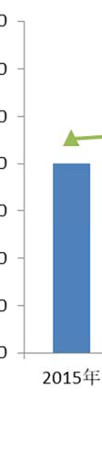



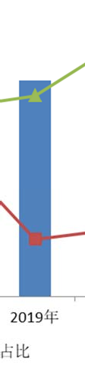
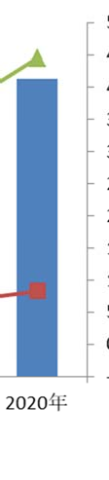


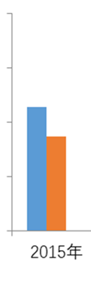


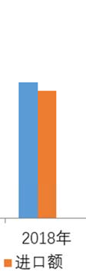
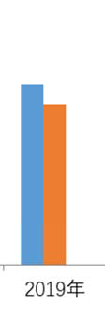
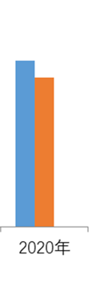
DEVELOPMENT, CHALLENGES AND IDEAS OF DIGITAL TRADE
USD 100
USD 100
2015
2016
2017
2018
2019
2020
2015
2016
2017
2018
2019
2020
Exports
Imports
Amount
speed
proportion
Figure Development of digital trade
during the "13th Five-Year Plan" period in China
Figure Digital trade exports and imports
during the "13th Five-Year Plan" period in China
Source: Service Trade and Business Service Department of Ministry of Commerce.
Source: Service Trade and Business Service Department of Ministry of Commerce.

Slide 17
DEVELOPMENT, CHALLENGES AND IDEAS OF DIGITAL TRADE
Table 2018-2020 Imports and exports of various digital services in China USD 100; %
Service category/indicator | 2018 Imports and exports of digital services in China |  |  |  | 2019 Imports and exports of digital services in China |  |  |  | 2020 Imports and exports of digital services in China
 | Export amount | YoY | Import amount | YoY | Export amount | YoY | Import amount | YoY | Export amount | YoY | Import amount | YoY
Digitizable services (total) | 1321.4 | 28.8 | 1240.4 | 17.7 | 1437.5 | 4.5 | 1284.6 | 3.6 | 1551.5 | 7.9 | 1396.1 | 8.68
Insurance services | 49.2 | 21.7 | 118.8 | 14.1 | 47.8 | -2.9 | 107.8 | -9.3 | 53.8 | 12.5 | 123.4 | 14.6
Financial service | 34.8 | -5.8 | 21.2 | 31.2 | 39.1 | 12.3 | 24.7 | 16.4 | 41.8 | 7.0 | 31.7 | 28.6
Telecommunication, computer and information services | 470.6 | 69.5 | 237.7 | 24.0 | 538.6 | 14.5 | 269.0 | 13.2 | 607.7 | 12.8 | 329.7 | 22.6
Among them: telecommunication services | 21.0 | 17.8 | 15.8 | -12.5 | --------- |  |  |  | ---------
Computer and information services | 449.6 | 73.0 | 221.9 | 27.7
Charges for intellectual property | 55.6 | 16.8 | 355.9 | 24.6 | 66.5 | 19.6 | 343.8 | -3.4 | 86.8 | 30.5 | 376.3 | 9.5
Among them: R&D achievement usage fee | 5.3 | -18.5 | 161.8 | 13.3 | --------- |  |  |  | ---------
License fee for audio-visual related products | 1.3 | 7.1 | 30.3 | 37.5
Personal, cultural and entertainment services | 12.1 | 59.8 | 33.9 | 23.2 | 12.0 | -1.3 | 40.8 | 20.2 | 13.2 | 9.8 | 30.1 | -26.3
Other business services | 699.0 | 13.6 | 472.8 | 10.3 | 733.5 | 4.9 | 498.5 | 5.4 | 748.2 | 2.0 | 504.9 | 1.3
Among them: Technology | 174.3 | 16.8 | 126.8 | 10.2 | --------- |  |  |  | ---------
Professional and management consulting services | 338.3 | 8.7 | 180.8 | 11.7
R&D achievement transfer fee and commissioned R&D | 93.0 | 16.6 | 70.6 | 23.9
Source： the Ministry of Commerce

Slide 18
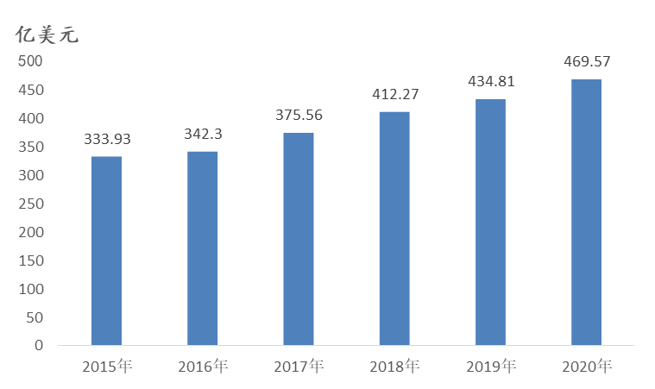
DEVELOPMENT, CHALLENGES AND IDEAS OF DIGITAL TRADE
(ii) Digital trade has become the main area of employment for college students.
As of 2019, 11.72 million people are employed in service outsourcing, with 2/3 of them having college degree or above. In 2019 and 2020, the Ministry of Human Resources and Social Security has successively released two batches of 29 new occupations, more than 75% of which are related to the digital economy. with games, e-sports, live broadcasting, and online literature creating approximately 11.45 million jobs. The China Sharing Economy Development Report (2020) released by the National Information Center shows that in 2019, about 78 million people were employed by the platforms.
(iii) Development status of China's digital service export sub-sectors
USD 100
1. Export of information technology services developed rapidly
—— Software exports have maintained rapid growth. From 2015 to 2020, it will increase from 33.39 billion U.S. dollars to 46.96 billion U.S. dollars, an increase of 40.6%.
2015
2016
2017
2018
2019
2020
Figure The scale of China's software exports
during the 13th Five-Year Plan period
Source: Service Trade and Business Service Department of Ministry of Commerce.

Slide 19
DEVELOPMENT, CHALLENGES AND IDEAS OF DIGITAL TRADE
—— Rapid development of the export of new generation of information technology services. In 2020, the export execution value of integrated circuit and electronic circuit design, information technology solutions, and network and information security services increased by 38.3%, 63.3% and 309.7% respectively, with that of cloud computing and AI services increased by 35% and 234.5%.
—— Accelerating expanding of international market of cloud services Amazon, Microsoft, and Google ranked among the top three, accounting for 33%, 18% and 9% of the global cloud service market. Alibaba Cloud ranked fourth in the world due to rapid development in Southeast Asia and African countries. BAT, Alibaba, and Tencent collectively account for 12% of the global cloud service market.
—— Constant expanding of international space of blockchain technology As the construction of the "Belt and Road Initiative" deepens, China and Malaysia, Indonesia, Kazakhstan, Singapore and other countries along the route have strengthened the application of blockchain technology in cross-border trade, digital currency and qualification certification.
—— Significant improvement in the global service capability of satellite navigation and location services Patent applications rank first in the world, and Beidou system-related products and services have been exported to more than 120 countries, among which more than 30 countries and regions along the "Belt and Road Initiative" have signed cooperation agreements with 137 countries around the world.
—— Accelerating internationalization of search engines In 2020, the international map of Baidu has been extended to more than 60 countries and regions, and it has gradually become an important tool for overseas travel services.

Slide 20






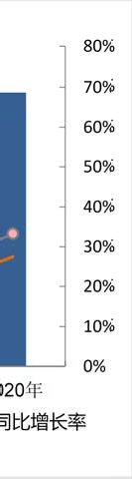
DEVELOPMENT, CHALLENGES AND IDEAS OF DIGITAL TRADE
2. Enhanced export strength of digital content services
In 2020, self-developed online game overseas sales revenue in China was 15.45 billion US dollars, an increase of 33.25%, covering more than 100 countries and regions. The United States, Japan, and South Korea are the largest markets, accounting for 27.6%, 23.9%, and 8.8% respectively and 60.3% in total.
The pace of "going out" of digital film and television and digital publishing has accelerated. By 2020, TV dramas had been exported to more than 200 countries and regions.
USD 100
Social media such as WeChat and short videos have accelerated overseas expansion, with China accounting for 3 of the top 8 social media across the world. There are nearly 4.49 million mobile Apps in China, ranking first in the world. In 2019, the global mobile APP downloads in Tik Tok ranked second in the world, with the oversea Tik Tok covering more than 150 countries and regions in 75 languages. Overseas versions of TikTok and Kwai are very popular in Japan, the United States, Russia, Turkey, Indonesia, Thailand and other countries.
2015
2016
2017
2018
2019
2020
Sales revenue of Chinese self-developed games in overseas markets
Self-developed games overseas market revenue growth rate
Self-developed game domestic market revenue year-on-year growth rate
Figure 2015-2020 Annual Overseas Sales Revenue of China's Self-developed Online Games
Source: Game Committee of China Phonetic Association

Slide 21
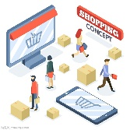

DEVELOPMENT, CHALLENGES AND IDEAS OF DIGITAL TRADE
3. The export competitiveness of digital services is enhanced
The service capabilities of cross-border e-commerce platforms have been rapidly improved. In 2020, cross-border e-commerce achieved 1.69 trillion yuan in imports and exports of goods, an increase of 31.1%. With the continuous transformation and upgrading of cross-border e-commerce, a new-generation cross-border e-commerce paradigm of B2B full-link, which integrates trade in goods and services, has been formed.
The digital payment international market is expanding rapidly. In 2019, Alipay's global users exceeded 1 billion, maintaining a growth rate of 20%. At present, 54 countries and regions can use Alipay for consumption. WeChat Pay covers 60 countries and regions and supports 16 different currencies for direct settlement.
4. Data trade has great development potential
According to IDC, the cross-border data flow in China globally accounts for about 23%. By 2025, the domestic share in the global data circle will increase to 27.8%, ranking first in the world.

Slide 22
DEVELOPMENT, CHALLENGES AND IDEAS OF DIGITAL TRADE
(iv) Offshore service outsourcing is the main way of digital service export
Offshore service outsourcing accounted for 68% of digitizable service export.
From 2016 to 2020, the implementation of China's offshore service outsourcing increased from USD $70.41 billion to USD $105.78 billion, with an annual growth rate of 10.7%. In 2020, the overall trade in services declined due to the impact of the COVID-19, while service outsourcing grew by 9.2%, boosting service export by 3.8 percentage points.
During 2016 to 2020, the proportion of Information Technology Outsourcing (ITO), Business Process Outsourcing (BPO) and Knowledge Process Outsourcing (KPO) was gradually adjusted from 46.9%, 16.6% and 36.5% to 43.9%, 16.1% and 40.0%, respectively. High value-added businesses such as R&D, industrial design, data analysis and mining, overall solutions, inspection and testing, and e-commerce platforms continued to grow.

Slide 23
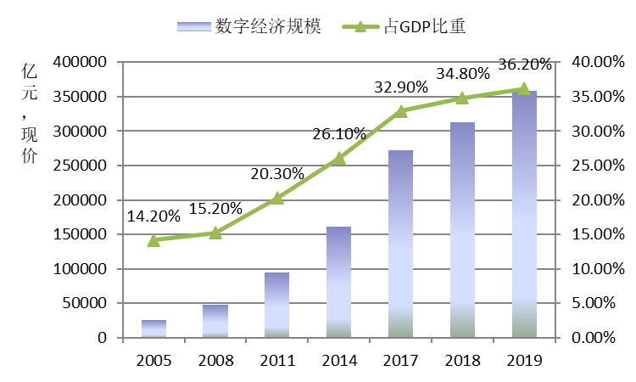
DEVELOPMENT, CHALLENGES AND IDEAS OF DIGITAL TRADE
III, China's development of digital trade has obvious advantages and also faces bottlenecks.
(iii) China's digital trade has a solid foundation for development.
Table China's increase values of digital industry and industrial digitalization and their proportion in GDP
In trillion CNY
1. Huge scale of digital economy. In 2020, the scale of digital economy in China reached 39.2 trillion CNY, accounting for 38.6% of GDP.
Year | Increase value of digital industry | GDP ratio | Increase value of industry digitization | GDP ratio
2005 | 1.33 | 7.3% | 1.28 | 7%
2008 | 2.03 | 6.4% | 2.78 | 8.8%
2011 | 2.96 | 6.3% | 6.53 | 13.9%
2014 | 4.21 | 6.8% | 12 | 19.3%
2015 | 4.78 | 7.1% | 15.85 | 20.5%
2016 | 5.2 | 7.0% | 17.39 | 23.3%
2017 | 6.15 | 7.4% | 21.02 | 25.4%
2018 | 6.4 | 7.1% | 24.88 | 27.6%
2019 | 7.1 | 7.2% | 28.75 | 29.0%
Digital economy scale
Shares of GDP
Trillion CNY Prevailing Price
Figure Scale and proportion of increase value of digital economy in China
Source: China Academy of Information and Communication Technology (CAICT), White Paper on China's Digital Economy Development (2020)
Source: sorting based on the data published by CAICT.

Slide 24
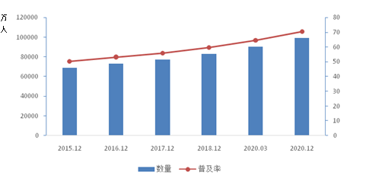
DEVELOPMENT, CHALLENGES AND IDEAS OF DIGITAL TRADE
In China, the scale of Internet, wireless broadband and mobile terminals ranks in the forefront of the world, and new technologies such as 5G, supercomputing and quantum teleportation are leading the world, basically building a high-speed information channel for key countries in the world. By 2020, the number of 4G base stations in China has reached 5.75 million, and more than 7.18 million 5G base stations have been put into services. The total length of optical cables has reached 51.69 million kilometers. International exporting bandwidth has been up to 11,511,397Mbps; The number of fiber-optic broadband access users reached 454 million, accounting for 93.9% of fixed Internet broadband access users. By 2020, netizens in China has reached 989 million, accounting for about 20% of the world's total netizens, with the Internet penetration rate up to 70.4%.
2. World advanced level of digital infrastructure
In ten thousand people
Qty.
Penetration rate
Figure Internet penetration rate and netizen scale in China
during the 13th Five-Year Plan period
Source: CNNIC, The 47th Statistical Report on China’s Internet Development.

Slide 25
DEVELOPMENT, CHALLENGES AND IDEAS OF DIGITAL TRADE
3. Clear advantages of super-large-scale market. It will promote the industrialization and large scale of new technologies, new business forms and new modes. The epidemic has brought unprecedented development to new digital business forms and modes such as online office, education, entertainment, medical care, exhibition and mobile payment.
4. Huge industrial scale and complete system. Intelligent manufacturing, intelligent service and intelligent agriculture will provide rich application scenarios and for the development of industrial Internet, and form large-scale data flow, so as to promote the development of the whole industrial chain of data in storage, transmission, processing and analysis.
5. Increasing international competitiveness of digital enterprises. World-class digital enterprises such as Huawei, Alibaba, Tencent and Baidu have emerged. China accounts for one third of the 32 AI unicorn companies in the world. According to the statistics of Statista, in 2020, there are five Chinese companies in the top ten social media in the world.
6. Increasingly rich open platform. China possesses 31 national service outsourcing demonstration cities, 12 national digital service export bases, 28 service trade innovation pilots, Hainan Free Trade Port and Beijing Digital Trade Port.

Slide 26
DEVELOPMENT, CHALLENGES AND IDEAS OF DIGITAL TRADE
(ii) Main problems and constraints
The comprehensive cost rises, and the competitiveness of undertaking international service outsourcing weakens. China's comprehensive costs of manpower, land, financing, taxation are rising, accelerating the transfer of information technology outsourcing to lower-cost countries and regions in South Asia and Southeast Asia. At present, the cost of a senior software engineer in China is about twice that of India, Vietnam and the Philippines, and the cost of office rent is twice that of India.
There is still a big gap in international competitiveness of digital enterprises between China and the United States. Among the world's 70 largest digital platforms, the US and China occupy first and second place respectively in terms of market capitalization, with the US accounting for 68% and China for just 22%, according to United Nations Conference on Trade and Development (UNCTAD). China's share of the market capitalization of the top 10 Internet companies dropped to 16% from 22% in 2017, while that of the United States rose to 84% from 78%.
The self-sufficiency rate of key technologies is low. Basic software, core components and high-end chips mainly rely on imports; The gap between China and the United States in semiconductor, operating system, cloud computing and other underlying and core technologies is even more significant.
1
2
3
4
5
6
7
There is a shortage of new generation digital technology talents such as big data, AI and cloud computing, and senior technical talents and leading talents are extremely rare. By 2025, the talent gap of big data, AI and cloud computing in China will reach 2.3 million, 5 million and 1.5 million, respectively.
The opening of knowledge-intensive service trade is insufficient. There are many restrictions on market access, facilitation of the movement of natural persons and data localization.
The level of digital trade is significantly lower than the global level, even lower than the US, the EU, the UK and other developed economies; In 2020, global digitizable service export accounts for 52%, while the US and UK accounts for more than 60%.
The statistical system is not perfect.

Slide 27
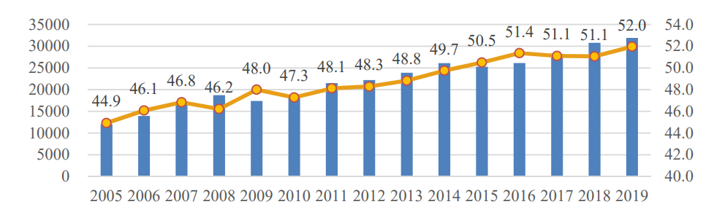

DEVELOPMENT, CHALLENGES AND IDEAS OF DIGITAL TRADE
IV. New opportunities and major challenges for China's digital trade development
(i) Major opportunities
1. Global digital trade will usher in great development and become the main engine of service trade development. According to the UNCTAD, global exports of digitally-deliverable services have grown at an average annual rate of 7-8% over the past decade. The application of 5G, big data, cloud computing, AI, blockchain and other new generation information technologies will accelerate the digital transformation of industries and expand the digital scope of service trade. The COVID-19 epidemic has speeded up the development of digital technology innovation and e-commerce. For example, the epidemic has boosted global Internet use and traffic, with traffic from Internet operators increasing by more than 60%.
Global trade export value in digitally-deliverable services (USD 100 million)
Proportion of global trade in digitally-deliverable services in global trade in services (%)
Figure Total trade of global digitally-deliverable services and their proportion in global service trade
Source: United Nations Conference on Trade and Development (UNCTAD).

Slide 28



DEVELOPMENT, CHALLENGES AND IDEAS OF DIGITAL TRADE
2. China's digital industrialization,
and industrial digitalization leave broad space for development.
3. Countries along the "the Belt and Road" (B&R countries) show great market potential.
The construction of the "Digital Silk Road" will improve the level of digital infrastructure in B&R developing countries, narrow the digital divide, so as to open up a huge market for digital enterprises in China. By January 2021, China had signed 205 the “Belt and Road” cooperation documents with 171 countries and international organizations.
The wide application of digital technology will vigorously promote the scale of digital industry. A number of industrial digital application demonstration industries such as smart port, smart mine, smart grid, smart factory, smart education, smart healthcare, smart agriculture, smart community and e-government have emerged.

Slide 29

DEVELOPMENT, CHALLENGES AND IDEAS OF DIGITAL TRADE
(ii) Increasing major challenges
1. Digital trade rules will become the focus of global trade rule reconstruction and competition in the future.
First, digital trade rules have become an important topic in bilateral and multilateral trade negotiations. According to the statistics of WTO, among the 286 regional trade agreements that came into effect in August 2018 and were notified to WTO, 217 agreements include clauses related to digital technology.
Second, global digital trade rules and digital governance are fragmented. Due to the differences of digital economy development stages, institutional systems and cultural concepts among countries, the global lack of unified digital governance rules will aggravate the digital divide and the imbalance of digital trade on important issues such as cross-border data flow, platform competition, platform responsibility, digital tax levying, digital currency, AI ethics and network digital security.

Slide 30
DEVELOPMENT, CHALLENGES AND IDEAS OF DIGITAL TRADE
Third, digital trade rules have become an important part of the construction of high-standard international economic and trade rules. Developed countries such as the US, the EU and Japan are taking the lead in making rules, trying to continuously occupy the commanding heights of future competition. Free trade agreements such as the United States–Mexico–Canada Agreement (USMCA), EU-Japan Economic Partnership Agreement (EU-Japan EPA), U.S.-Japan Digital Trade Agreement and Comprehensive and Progressive Agreement for Trans-Pacific Partnership (CPTPP), which have been signed since 2018, embody high-standard rules dominated by developed countries.
Table Main clauses of four major free trade agreements on digital trade
Clauses | RCEP | CPTPP | USMCA | EU-JAPAN EPA
Definition of digital product |  | Computer programs, texts, videos, images, audio recordings, or other products that are digitally encoded, produced, used for commercial sales or distribution and can be transmitted electronically. | Same as CPTPP
Zero-tariff | √ | √ | √ | √
Non-discriminatory treatment of digital products |  | √ | √
Legal effect of electronic authentication and electronic signature | √ | √ | √ | √
Personal privacy protection | √ | √ | √ | √
Encouragement of paperless trade | √ | √ | √
Free flow of cross-border data | √ | √ | √ | √
Network security | √ | √ | √ | √
Source code protection |  | √ | √ | √
E-commerce cooperation | √ | √ | √ | √
Source: sorting based on the texts of the mentioned agreements.

Slide 31
DEVELOPMENT, CHALLENGES AND IDEAS OF DIGITAL TRADE
—— The United States promotes the free and open digital service market, focusing on digital service market access, non-discriminatory treatment, free flow of cross-border data, non-mandatory localized storage of data, source code protection and others.
—— Japan proposes cross-border data flow based on trust. At the G20 Osaka Summit in 2019, 24 countries and regions signed the Osaka Declaration on Digital Economy, promising to boost the free flow of global data and formulate rules.
—— The EU pays more attention to privacy protection while recognizing the free flow of cross-border data and the opening of digital service market. The European Commission announced the "Digital Single Market" strategy in May 2015, and the General Data Protection Regulation (GDPR) implemented in 2018 reflected these ideas.
Fourth, developing countries are in a defensive position in terms of digital trade rules. Implement the policy of data localization or restricted cross-border data flow. For example, India, Indonesia and South Africa refused to sign the Osaka Declaration on Digital Economy, and Russia, India, Brazil and other countries advocated the localization of data storage. India requires companies to keep part of their IT infrastructure onshore and prohibit payment data from out of the country. Brazil promulgated the Lei Geral deProteção deDados Pessoais (LGDP) in 2018, and Turkey prohibited the free flow of personal data across borders.

Slide 32
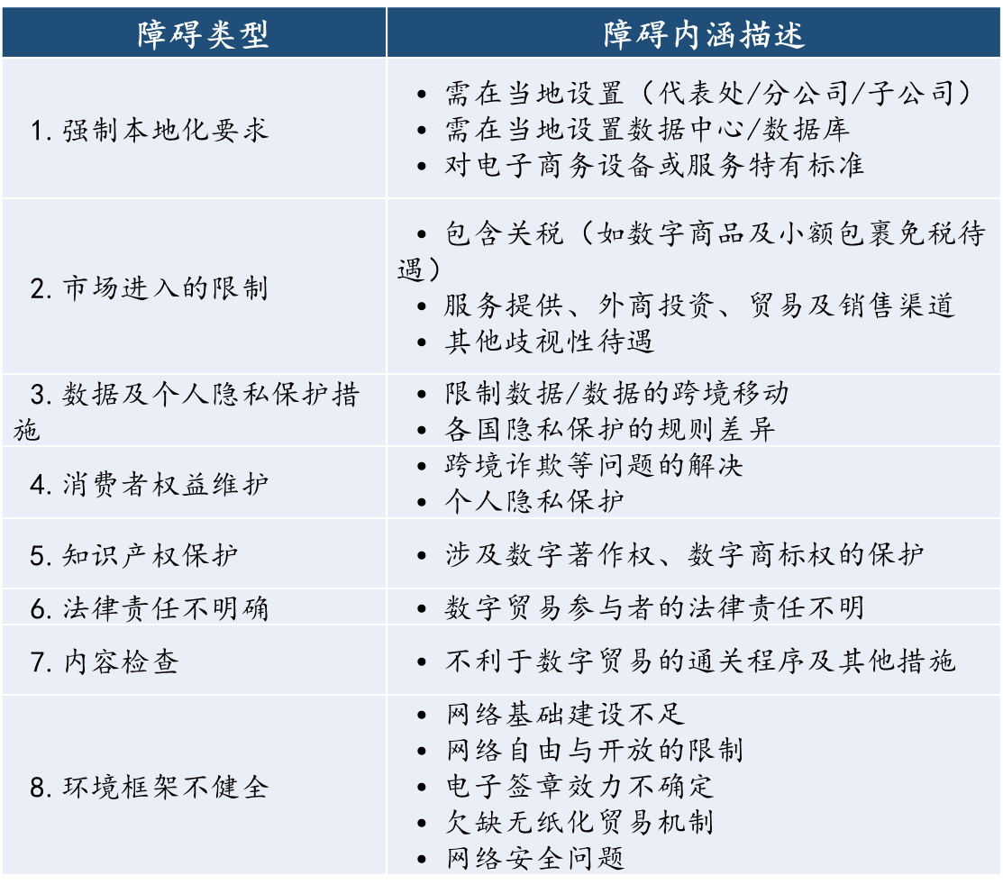
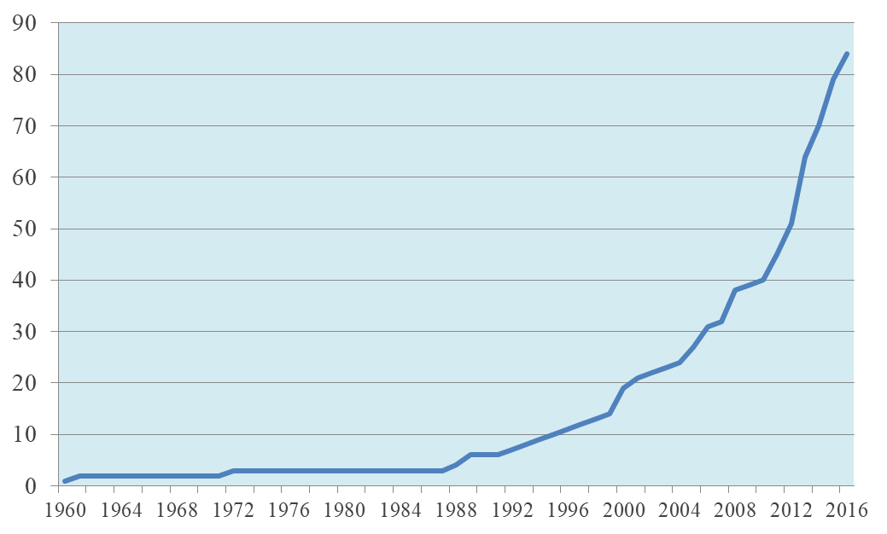
DEVELOPMENT, CHALLENGES AND IDEAS OF DIGITAL TRADE
Fifth, restrictive measures for digital trade have increased. Restrictive measures on the grounds of national security and personal privacy are increasing. It is mainly reflected in the restrictions on the free flow of cross-border data, localized storage of data, market access of digital services and national treatment and the like.
Table Types and main contents of global digital trade barriers
Type
Description
Need to set up (representative office/branch/subsidiary) in local area
A data center or database must be set locally
Specific standards for e-business equipment or services
1. Enforcement of localization requirements
1. 强制本地化要求
Include tariffs (e.g. duty-free treatment for digital goods and small parcels)
Service provision, foreign investment, trade and sales channels
Other discriminatory treatment
2. Restrictions on market access
3. Data and personal privacy protection measures
Restrict data/data movement across borders
Privacy protection rules vary from country to country
4. Consumer rights protection
Cross-border fraud and other problems
Personal Privacy Protection
5. Intellectual property right protection
Protection of digital copyright and digital trademark right
6. Indefinite Legal
The legal liability of digital trade participants is unclear
7. Content inspection
Customs clearance procedures and other measures that are detrimental to digital trade
Inadequate network infrastructure
Restrictions on Internet freedom and openness
The validity of electronic signature is uncertain
Lack of paperless trading mechanism
Network security issues
8. Imperfect environment framework
Figure Quantity of restrictive measures in global digital trade
Source: European Center For International Political Economy (ECIPE), Digital Trade Restrictiveness Index
Source: sorting based on APEC, OECD and WTO reports.

Slide 33
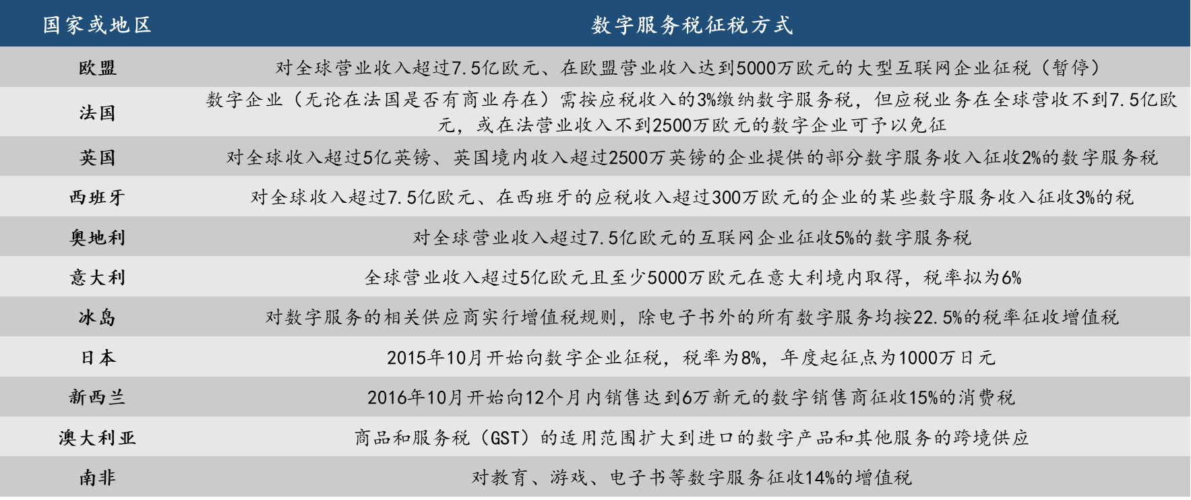
DEVELOPMENT, CHALLENGES AND IDEAS OF DIGITAL TRADE
Sixth, the number of countries levying digital tax is expanding. The EU is developing as a main promoter of digital service tax, the US believes that digital service tax is a discriminatory tax against American enterprises.
Table Digital service tax in main countries
States or regions
Taxation of digital services tax
EU
Tax on large Internet companies with global revenues of more than €750m and REVENUES of €50m in the EU (suspension)
France
Digital businesses - regardless of whether they have a commercial presence in France or not - are subject to the DST at 3 per cent of their taxable income, but are exempt if their taxable business has less than €750m in global revenues or €25m in French revenues
UK
A 2% digital services tax will be levied on part of digital services revenue provided by businesses with global revenues of more than £500m and revenues of more than £25m within the UK
Spain
A 3% tax will be imposed on certain digital services income from companies with global revenues of more than €750m and taxable income of more than €3m in Spain
Austria
A digital services tax of 5% will be levied on Internet companies with global revenues of more than 750 million euros
Italy
Global revenue of more than 500 million euros and at least 50 million euros earned in Italy, the tax rate is proposed to be 6%
Iceland
VAT rules will be applied to suppliers of digital services, with all digital services except e-books being subject to VAT at a rate of 22.5%
Japan
The tax on digital companies began in October 2015, with a tax rate of 8 percent and an annual threshold of 10 million yen
New Zealand
In October 2016, a 15% GST was levied on digital sellers whose sales reached S $60,000 within 12 months
Australia
The goods and Services Tax (GST) has been extended to cover the cross-border supply of imported digital goods and other services
South Africa
A 14% value-added tax will be imposed on digital services such as education, games and e-books

Slide 34
DEVELOPMENT, CHALLENGES AND IDEAS OF DIGITAL TRADE
3. The Sino-US strategic game is long-term and complex. Digital technology and digital trade are two main areas of competition, with "Decoupling Theory" spreading constantly. The US is the main partner of China's information technology introduction and service outsourcing, which affects bilateral cooperation.
2. The impact of the global COVID-19 has led to a decline in the growth rate of global economy, trade and investment, which has resulted in the intensification of protectionism.
4. The problem of digital security has become increasingly prominent. Personal data leakage, hacker attacks, invasion of industrial data systems and other security incidents occur frequently. WHO reported a 500% year-on-year increase in the number of cyber attacks in the first half of 2020.

Slide 35
DEVELOPMENT, CHALLENGES AND IDEAS OF DIGITAL TRADE
V. Main ideas to promote the development of digital trade
(i) Comprehensively improve the ability of technological innovation, business form innovation and mode innovation.
—— Give full play to the advantages of the new national system and China's strategic capacity in science and technology, so as to break through the bottlenecks of key core technologies such as high-end chips, basic software and infrastructure.
—— Cultivate internationally competitive digital platform enterprises, build the digital economy innovation ecology based on the platform, improve the industrial chain, stabilize the supply chain, reinforce the innovation chain, and establish the mechanism of data opening and sharing and the development mode of data-driven innovation.
—— Encourage digital enterprises to increase R&D investment and strengthen the global layout of intellectual property rights. Besides, improve the legal system of intellectual property protection.

Slide 36
DEVELOPMENT, CHALLENGES AND IDEAS OF DIGITAL TRADE
(ii) Drive all-round digital transformation of industry, trade and enterprises.
Accelerate the integration and penetration of 5G, big data, cloud computing, AI, blockchain and other digital technologies with public service departments such as manufacturing, mining, service industry, agriculture and healthcare, education, culture, sports and government, and continuously elevate the digital industrialization and industrial digitalization.
Expand the digital service import related to manufacturing, such as information technology, R&D and design, and intellectual property rights, and support technological innovation and value chain upgrading. Drive the related digital service export such as finance, insurance, settlement, e-commerce, supply chain management relying on trade in goods to increase the value-added level of trade value chain.
Make full use of the advantages of data resource integration of platform enterprises to provide services for traditional enterprises. Build up intelligent manufacturing system to develop remote maintenance and data service.

Slide 37
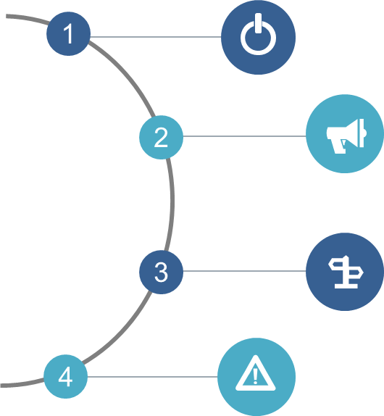
DEVELOPMENT, CHALLENGES AND IDEAS OF DIGITAL TRADE
(iii) Explore the international rules of digital trade under the guidance of institutional openness
Continue to reduce the negative list of foreign market access, expand the opening of digital technology, healthcare, culture, education, value-added telecommunications, professional consulting and other service industries, aiming to attracting multinational companies to set up offshore data centers, settlement centers and R&D centers, and improving the level of digital delivery.
Enhance coordination with developed countries, strengthen market integration, rule docking and mutual recognition of standards by promoting bilateral and regional free trade agreements, and jointly push forward WTO reform.
Speed up the construction of digital trade rules system and contribute to China's plan by driving the RCEP implementation, the China-EU Comprehensive Agreement on Investment landing, reinforcing "the Belt and Road Initiative" digital economic cooperation.
Take the lead in benchmarking CPTPP rules in Pilot Free Trade Zone, Hainan Free Trade Port, Innovative Pilot of Trade in Service and national digital service export demonstration base, and conduct stress tests in facilitating cross-border free flow of data, intellectual property protection, personal privacy protection, network data security and international supervision. Explore the negative list management system of trade in cross-border service.

Slide 38
DEVELOPMENT, CHALLENGES AND IDEAS OF DIGITAL TRADE
(iv) Enhance international cooperation in digital trade under the guidance of building the "Digital Silk Road"
Deepen the markets in Southeast Asia and South Asia relying on China's digital technology and service advantages, promote information technology service export such as cloud services, search engines and location services, as well as the of digital service export such as animation games, remote education, telemedicine, digital media and digital publishing. Moreover, develop service outsourcing like data storage and processing, R&D and design, and remote maintenance, and expand cooperation between mobile payment and digital currency. Maintain international cooperation in cross-border e-commerce.
Meanwhile, it is necessary to reinforce the construction of information, law, early warning and insurance system to prevent the risk of enterprises going out.
(v) Coordinate openness with security
Data has become the core strategic resource and the key element to participate in international competition. It is critical to put data security in a vital strategic position of national security. Speed up the improvement of data security rating, personal privacy protection and other related laws, as well as the system for determining, trading and using data resources. Explore and establish the whitelist system of cross-border data flow cooperation with relevant countries.
(vi) Improve the digital trade statistical system
Perfect the statistical system, such as determining the boundary, unifying international caliber, guaranteeing the law, cooperating with departments and making publicity and promotion.

